Slide 1
Secondhand Marketplace2 MVP Pre-GreenCheck AI
Alex Hetherington
Euan Chan XuanXi
Freddie de Bruyn

Slide 2
Journey from previous project to now
Joined GreenCheck AI
Deciding and choosing new project
Find out issues and risks
Ask for advice and confirmation
Joined Secondhand Marketplace

Slide 3
Previous Project: GreenCheck AI
GreenCheck AI is a project that utilize Explainable AI (XAI) for sustainability fraud (greenwashing) detection, providing clear, plain-language explanations for every flagged sustainability claim, in English, German and Spanish.
Client: Legal Pythia - legal tech startup aims to help legal, finance and government bodies to manage large volumes of documents and data more efficiently using XAI for identifying fraud, detecting greenwashing and managing administrative/legal workflows.
Meeting with client (CEO of Legal Pythia):
Having international users, language will be handled on their side
Wants us to build on their existing codebase, open to any extensions we want to do
Is non-technical, need to contact CTO for explanation for existing code

Slide 4
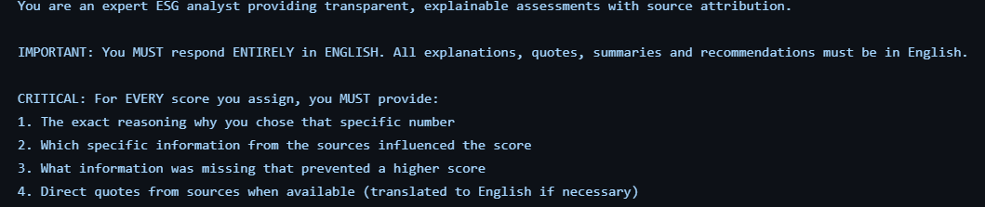
Previous Project: Finding out issues
Meeting with CTO:
Backend = prompt engineering, wrapper around Gemini
Fully ai generated frontend and over 50% backend code
CTO not being able to explain the existing codebase - saying that it is self-explanatory
Example of code (prompt) CTO presented to us in their current code:

Slide 5
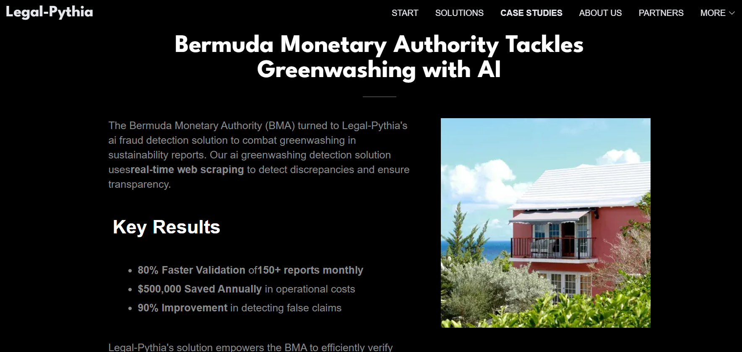
Previous Project: Finding out issues
Use of previous years’ project as their demo of successful projects

Slide 6
Previous Project: Resolving issues
With the help and Advice from Sarah:
We cannot build things based on their existing codebase
Left with 3 Options for us
Continue with the same client but start from scratch to build the product
Select another project and transfer together as a team of 3 or 4
Split and select different projects that suits out interest
Originally 4 people turned into 3 people – one member of the previous group split due to interest of projects not overlapping
Finally decided to go for Secondhand Marketplace

Slide 7
Current Project Scope and Context
Unique online secondhand market platform that emphasizes on fun interaction and credibility
Client: Marius, an individual who has a strong passion for this project

Slide 8
User stories
As a Buyer, I want an engaging and interactive marketplace to easily find the items I'm looking for, and to explore reviews and ratings of sellers. I would also like to browse or be recommended items that would interest me, with the option to filter.
As a Seller, I want a user-friendly marketplace to conveniently list the items I want to sell, and for them to reach the right audience of potential buyers.
As a Highly rated Seller, I want a reliable system allowing buyers to trust me and enabling me to have an impactful and leading role in the community, potentially building a brand/identity.

Slide 9
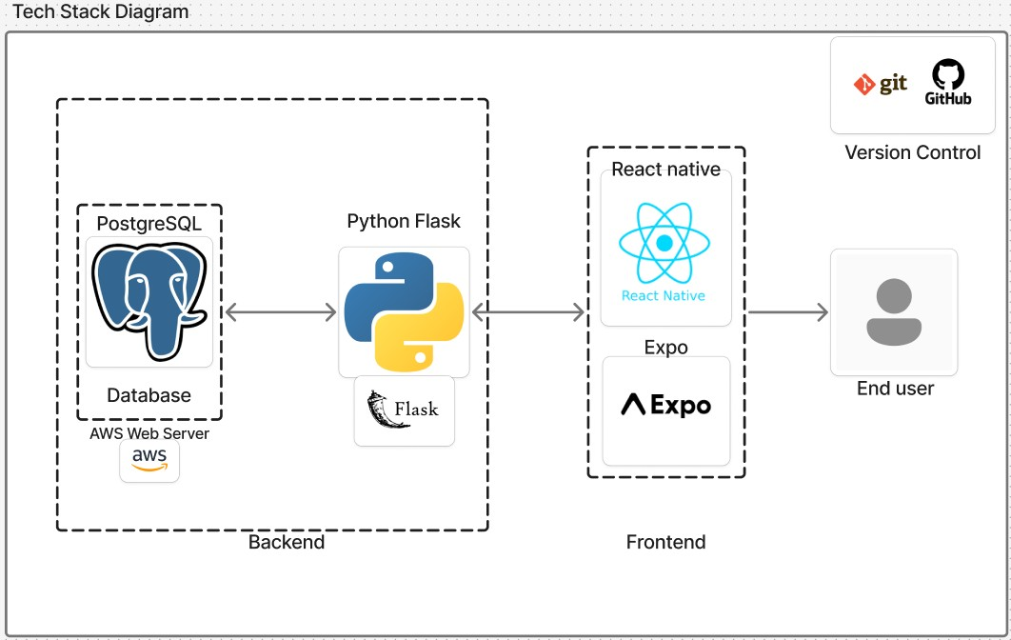
Tech Stack Diagram

Slide 10
Main ideas of the product :
Case studies :
Revolut – Smooth and simple UI
Duolingo – Gamification of interactions
Airbnb – review system
YouTube – Recommendation engine

Slide 11
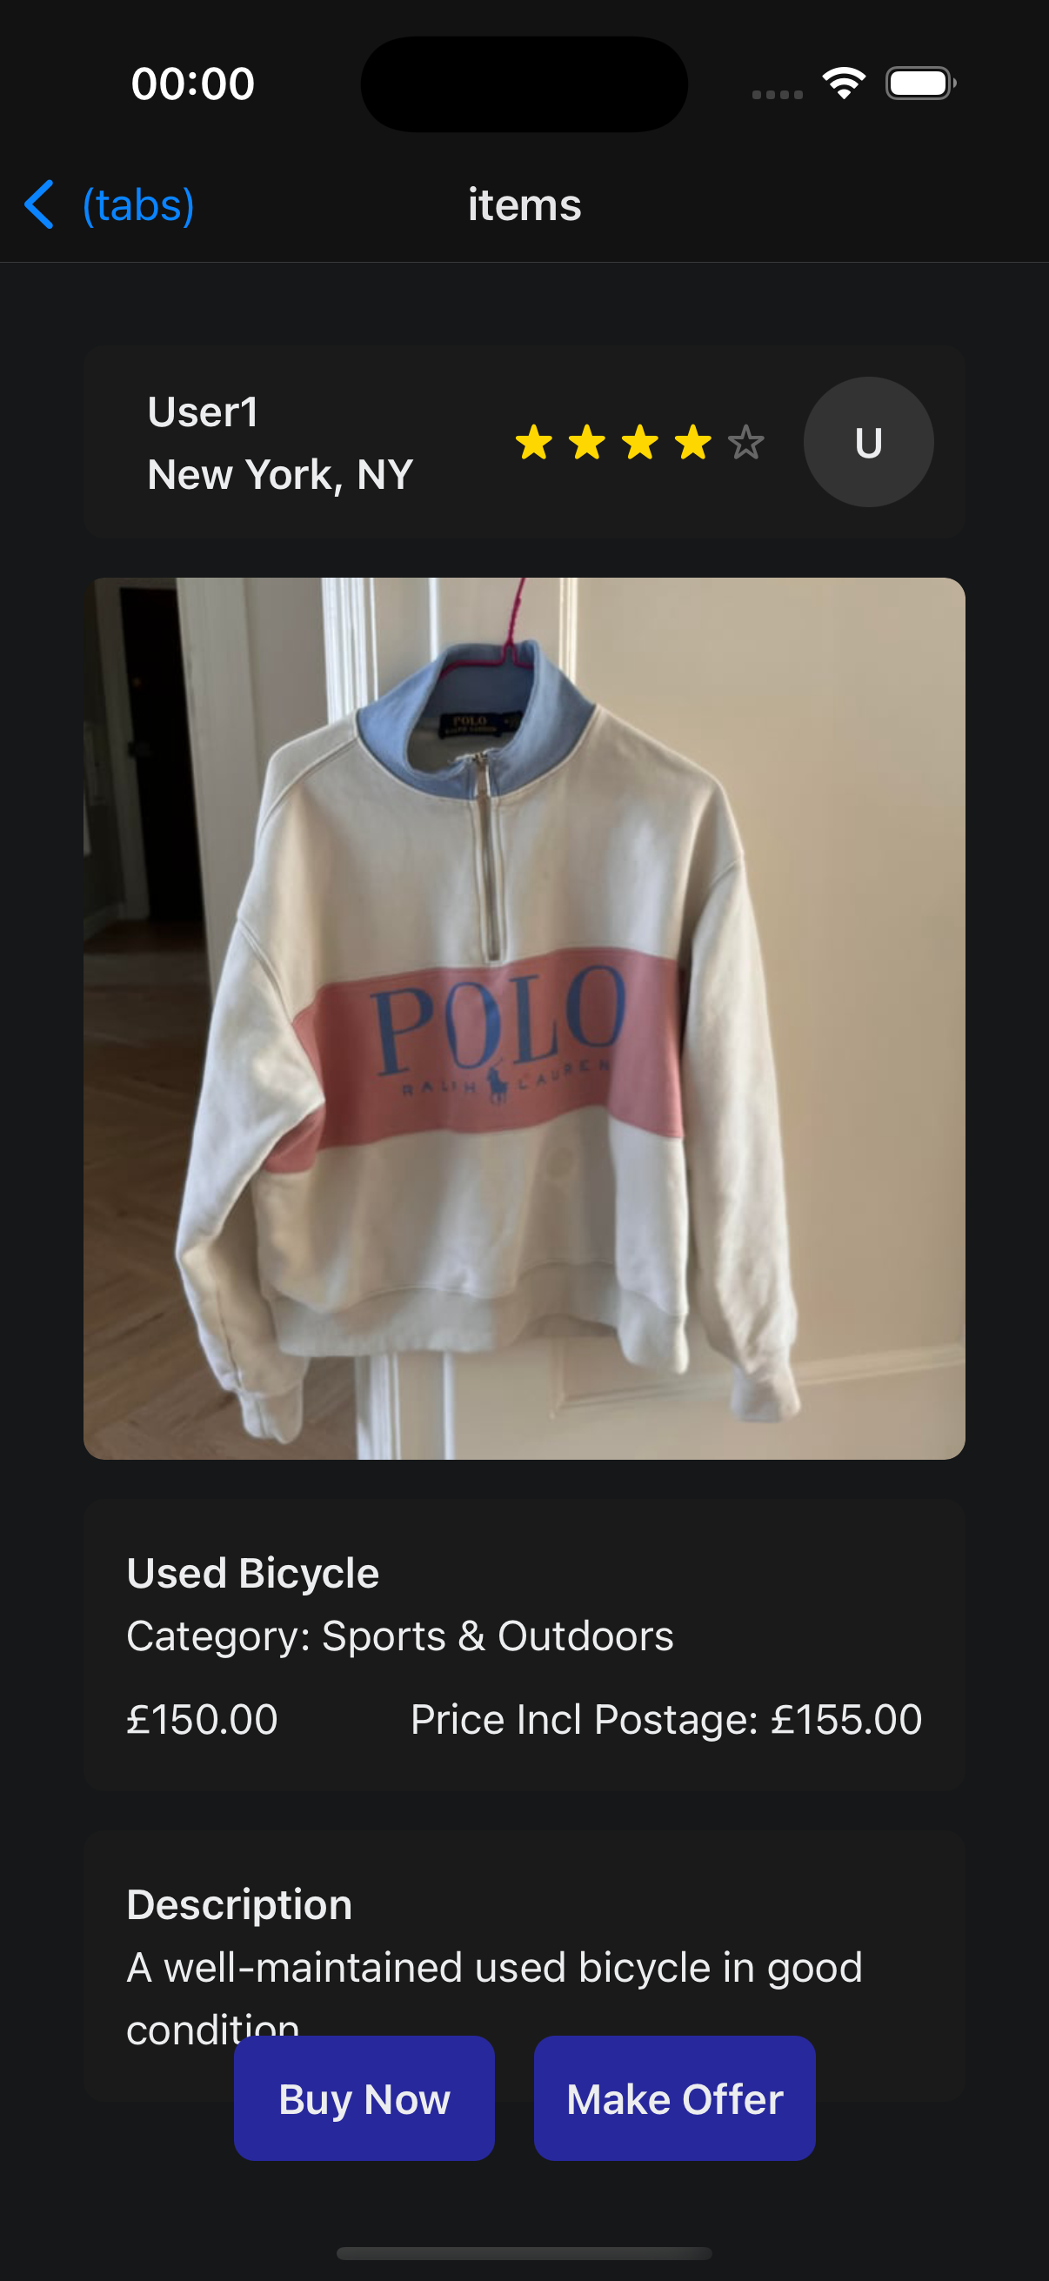
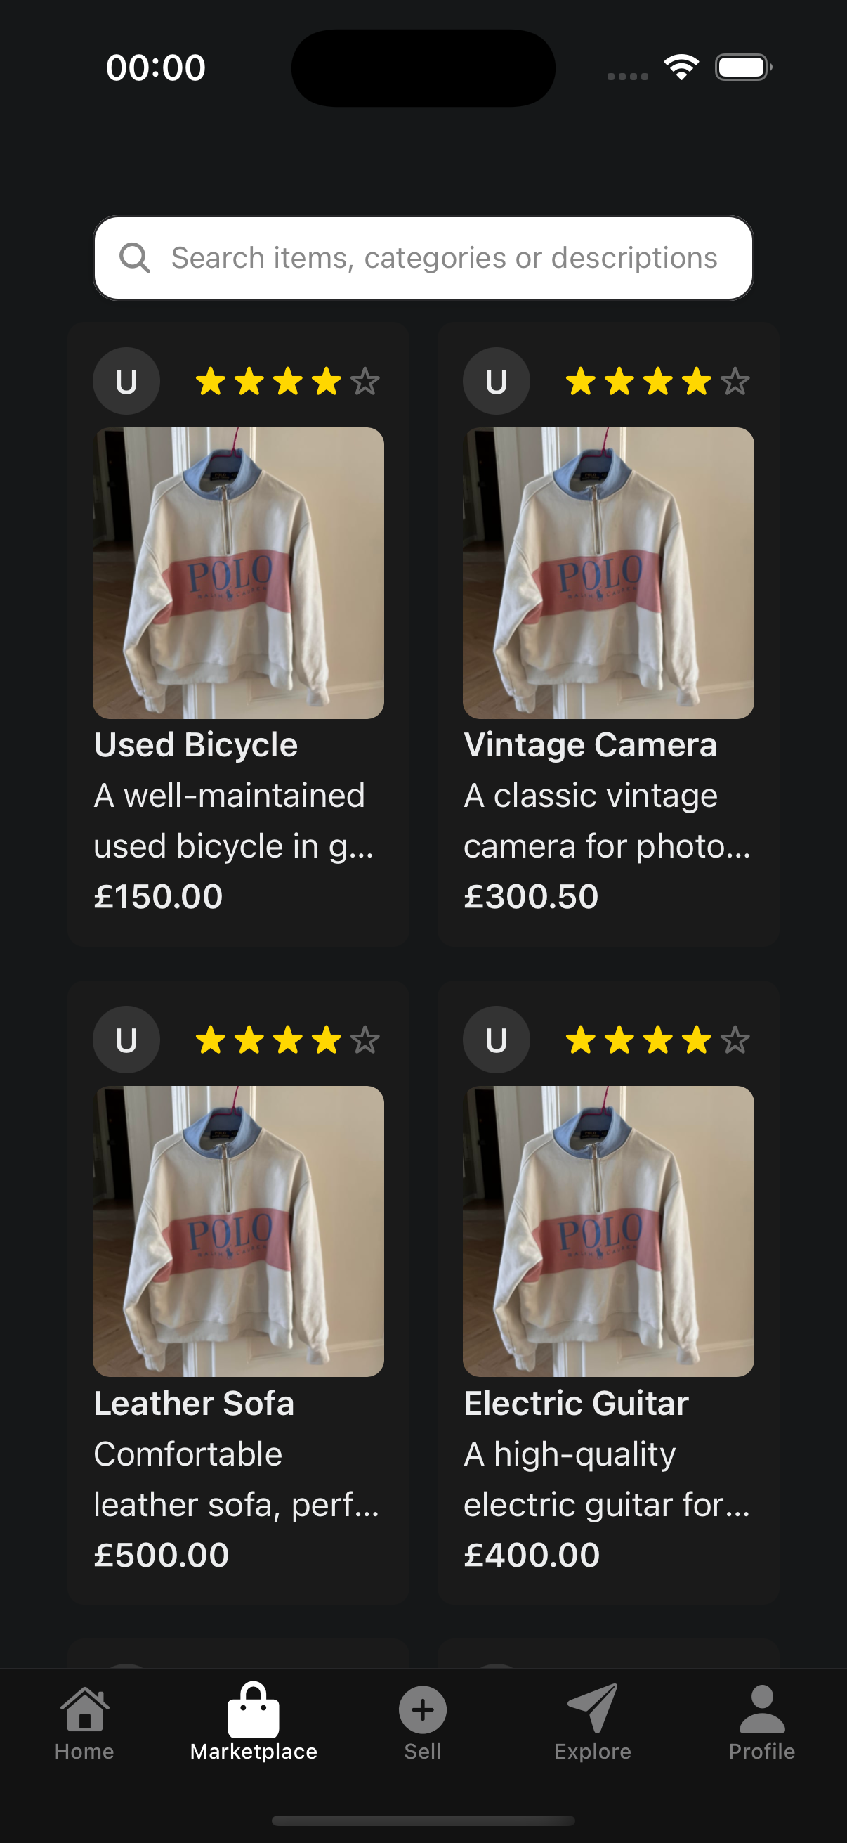
Frontend Demo
Features:
Search Bar
Seller's profile and rating
Image
Listing name
Abbreviated listing description
Price
Haptics for listings and search bar
Features:
Seller's Profile including approximate location
Listing image
Listing name
Full description
Price including price with postage
Buy and Sell buttons
Haptics for buy and sell buttons
Marketplace Tab
Item Listing

Slide 12
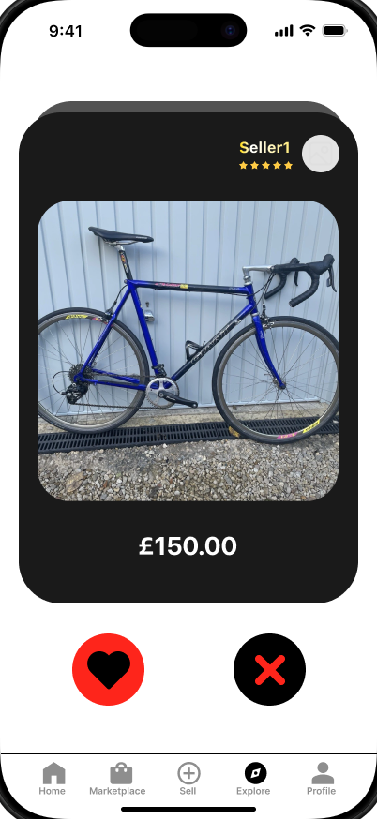
Prototype Idea: Swipe and Explore
Key Ideas:
Keep the interaction with the user as simple as possible.
User is given a personalised feed of listings.
Only essential information about the listing shown (price & image).
When the user likes a listing, it will be added to their liked items which they can then review later.

Slide 13
Product Future Roadmap
Integrating into a working platform, deciding UI/UX style
Recommendation engine that records user preferences
Gamification of User interactions with simple interface
Review system for sellers and users to check credibility

Slide 14
Process
We meet every week in person to discuss about what needs to be done and allocate workload to everyone. We take guidance from our mentor for how to do this most effectively, ensuring each member has neither too much nor too little work.
The current project manager is Alex, regularly checking on everyone’s progress and decide what should be prioritized for this period.
Communication: We constantly check with client with our updated progress and ask for feedback. We also inform each other within the team to ensure workloads / meetings can be adjusted to achieve goal in a reasonable way.

Slide 15
Future Project Management
Rotating Project managers and rotating frontend/backend roles
Define concrete end goals from the start and break it down into smaller goals for each stage
Using more tests and CI/CD

Slide 16
Questions

